Slide 1
Communication protocols IoT-related Messaging approaches
Internet of Things
Module lead: Dr Mir Seyedebrahimi

Slide 2
Communication protocols
We have already connected IoT things to the network using Ethernet, WiFi and onboard wiring. Now we would like to have a look at some applications that are running on top of the physical mediums and are used for sending and receiving the IoT data.
IoT-related communication protocols are the agreed structure/format used for communication between IoT-enabled devices.
This also defines what should be sent and received and what actions should be taken.

Slide 3
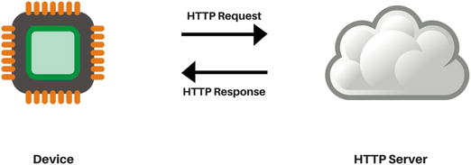
HTTP
Hyper Text Transfer Protocol (HTTP) is the underlying protocol of WW web:
It is based on client–server architecture
operates in a request and response fashion
HTTP supports various transmission methods including:
GET: URL carries the defining parameter of request
POST: message body contains the request parameters
POST considered more secure and less limited from data point of view

Slide 4
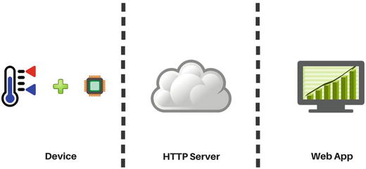
HTTP for IoT
Note that:
HTTP uses TCP (transmission control protocol) to provide reliable connections
It is stateless and client/server do not maintain a connection during the communication
In IoT, HTTP likely to be reliant on a web app to serve the IoT-enabled devices

Slide 5
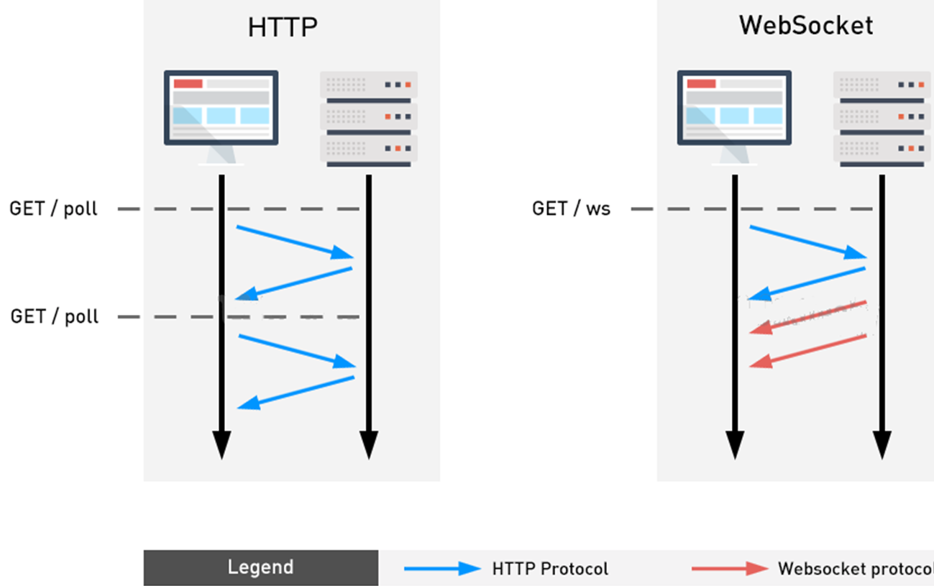
HTTP vs WebSocket
WebSocket is a communication protocol designed for web browsers and web servers:
unlike HTTP, WebSocket provides full‐duplex communication over a single TCP connection
WebSocket is stateful, as the client and server do maintain a connection during the communication
Source: https://diophant.com/wp-content/uploads/2019/01/websocket-vs-http11.png

Slide 6
Related activity
Please follow the instructions of Activities 6 and 7:
Load a program from server to MCU
Load a program from server to SBC and the to MCU through usb port

Slide 7
MQTT
MQTT is a lightweight machine-to-machine protocol and:
It is a publisher-subscriber model
publisher publishes data to a server (a.k.a., a broker)
subscribers receive the data from server
Publisher and subscriber don’t know each other:
Communication is asynchronous
Broker notifies all subscribers about the published Thing (i.e. the ‘topic’ concept):
A topic is similar to a newsfeed, in that you subscribe to certain topics you want to receive news about
Publishers and subscribers could be sensors, machines, and mobile apps

Slide 8
MQTT in IoT
For example if a sensor acts as a publisher
Sensor publishes a new data to a topic (e.g. home/1stfloor/room2) on the MQTT broker
The MQTT broker will add this message to the topic
Multiple users are subscribers of home/1stfloor/room2 topic and they will be notified about the latest data

Slide 9
Related activity
Please follow the instructions of Activity 8:
Create an IoT-enabled object
Register a parameter of this object through MQTT architecture
Inform multiple devices around the network the latest status of this parameter

Slide 10
End of session

